Slide 1
ToFoo Functionality Demonstration
By Andrew Woll

Slide 2
Environment Configuration
Instructions for Database Configuration
1. Place the code directory in your “htdocs” folder of your “xampp” directory then start Apache and MySQL servers through the XAMPP Control Panel.
2. Type in “localhost” in your web browser. This will take you to your Apache server dashboard.
3. In the top right-hand side of the webpage, select “phpMyAdmin” and log in to your account.
4. Click “New” on the left-handle side of the webpage to create a new database.
5. Name this database “foodorderdb”.
6. Head to the tab titled “SQL” which is located at the top of the webpage.
7. Input all the code within the file “foodorderdb.sql” in the first large text box then press “Go” at the bottom of the webpage.
8. The SQL database is now structured and filled with data. In order to connect to the database with the code, change the data within “config/connection-details.txt” to match your username and password you used to sign into phpMyAdmin. The data in the text file is formatted as follows: “host,username,password,database”.
9. The text file is read by “util/db.php” so that its data is used to connect to the database once the code is run. With all the steps completed, input “localhost/foodorderapp/index.php” into your web browser and the website will be displayed.

Slide 3
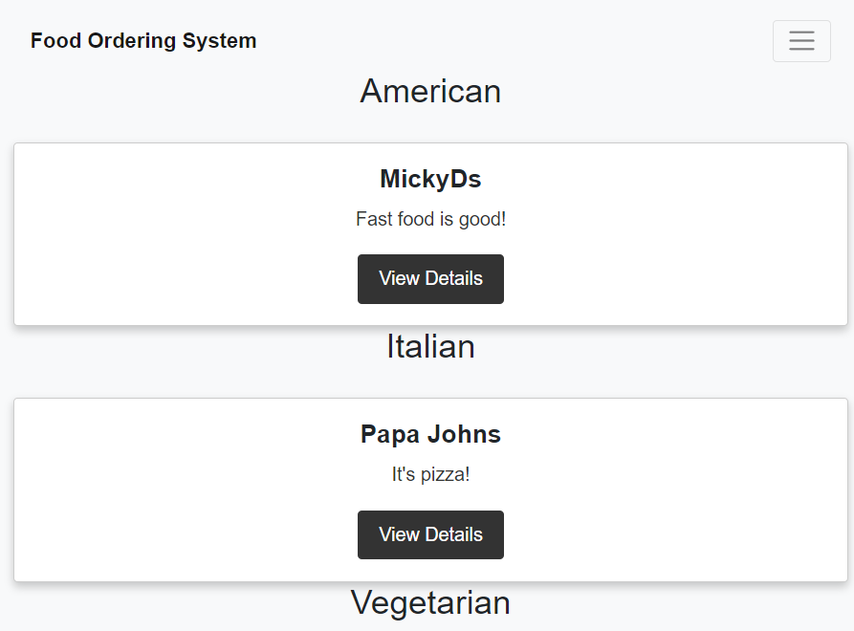
Home Page (Not Signed In)
Note: Views display website when browser is half-screen
This is the Home screen of my food ordering website. It displays restaurants in a list based on their categories with a list of all restaurants at the bottom. At this stage, users can select “View Details” and see the Profile page of the selected restaurant.

Slide 4
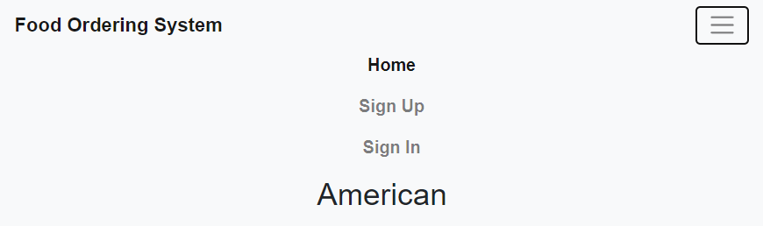
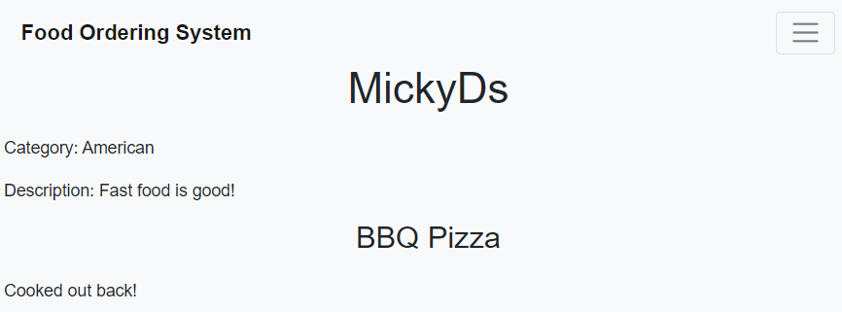
Restaurant Profile (Viewer/Not Signed In)
Navigation Bar
This is the view of the navigation bar before someone has logged in. When selecting “View Details”, users will be shown the Profile page without the button for placing an order.

Slide 5
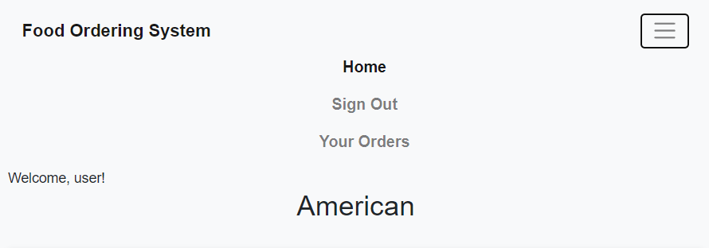
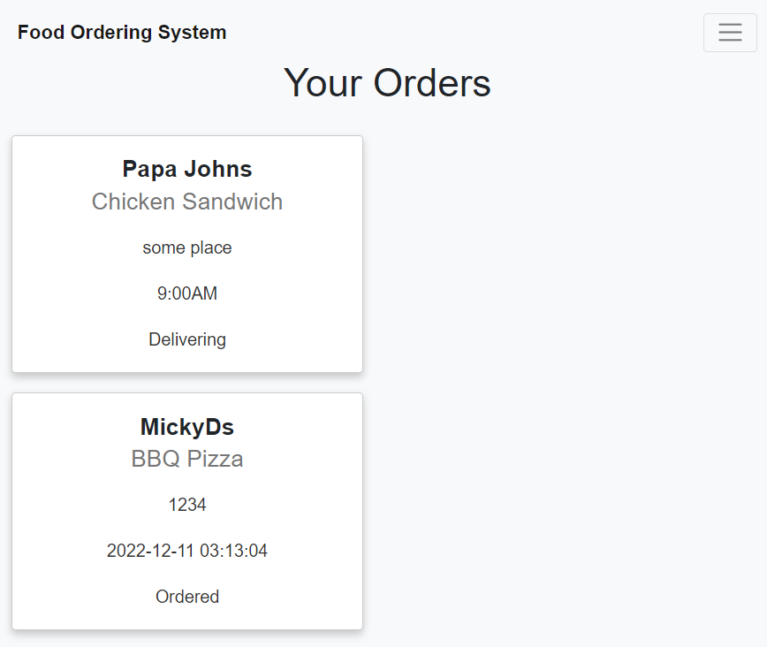
Navigation Bar (User/Signed In)
Your Orders (User)
This is the view of the navigation bar once a user (not admin) has logged in. Users now have an option to view a “Your Orders” page that will list the orders which the user currently has placed. Cards display the restaurant, meal, address, time, and status of each specific order.

Slide 6
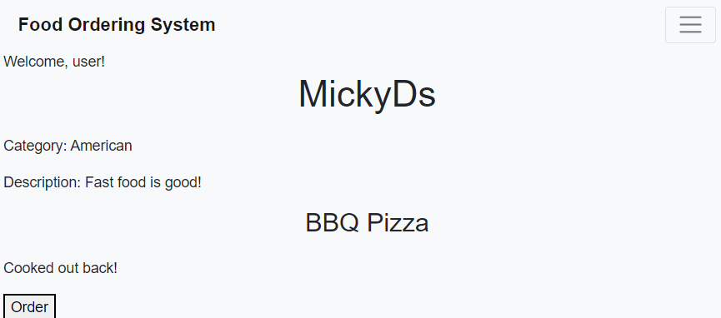
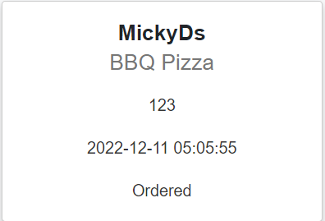
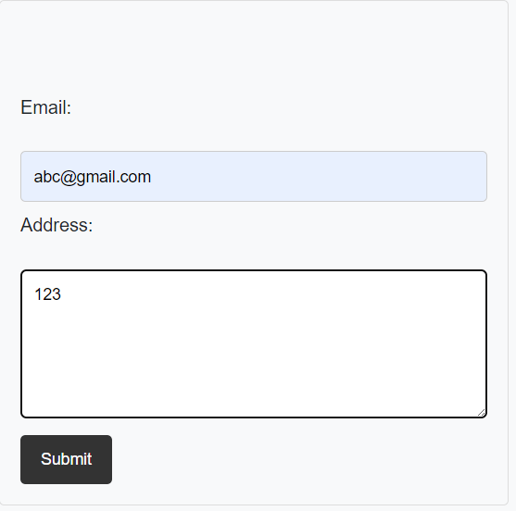
Restaurant Profile (User)
Updated Your Orders (User)
When users are signed in, they will see an “Order” button below each meal on the profile page which will display an input box where an email and address can be determined. Upon clicking the “Submit” button, a new order is created and users will be able to see the order’s details on their “Your Orders” page.

Slide 7
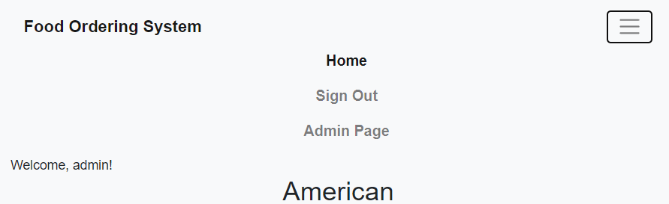
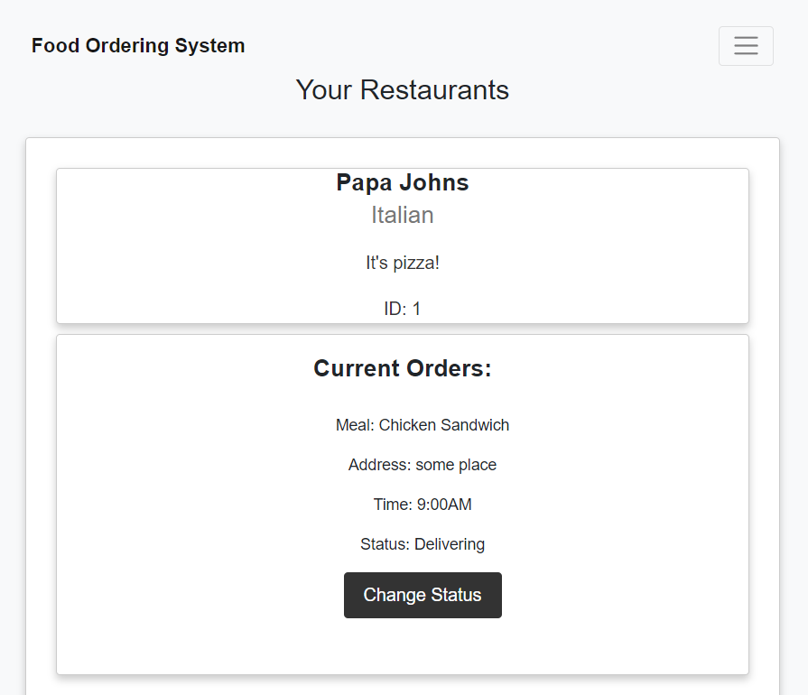
Home (Admin/Signed In)
Admin Page
This is the view of the navigation bar once an admin has logged in. When selecting “Admin Page”, admins will be shown a page housing all the information and functionality for manipulating restaurant related content. As you can see on the right, a restaurant is displayed with all the current orders placed.

Slide 8
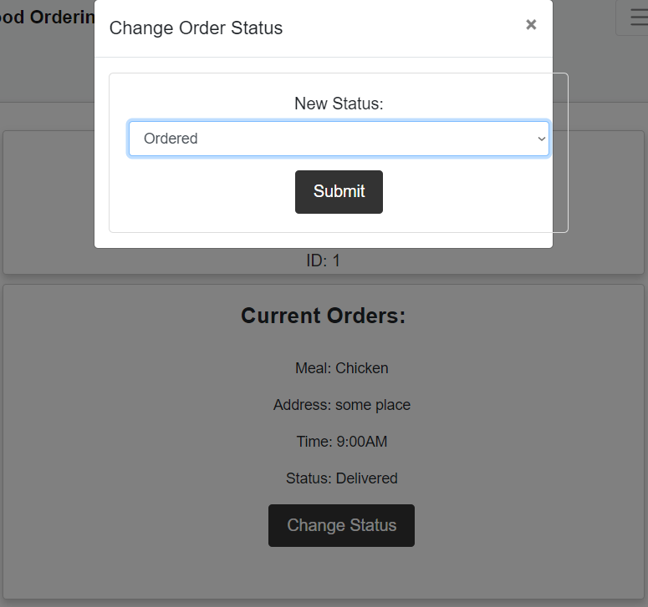
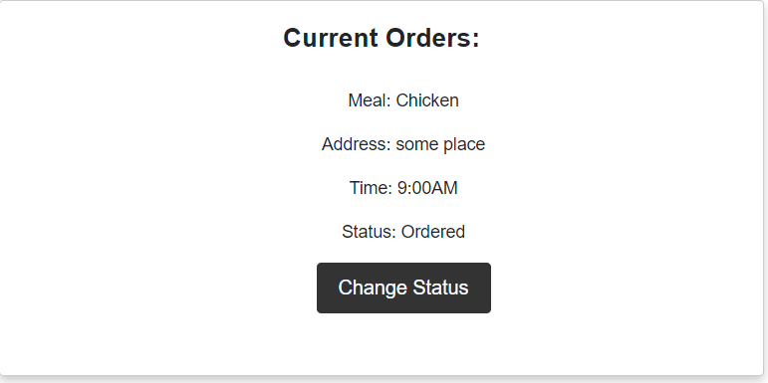
Change Order Status
Updated Order Status
On the “Admin Page”, each order has a button associated with it that allows an admin to change the status of an order through selection from a dropdown box. Clicking “Submit” will result in content being reloaded and displaying the updated status

Slide 9
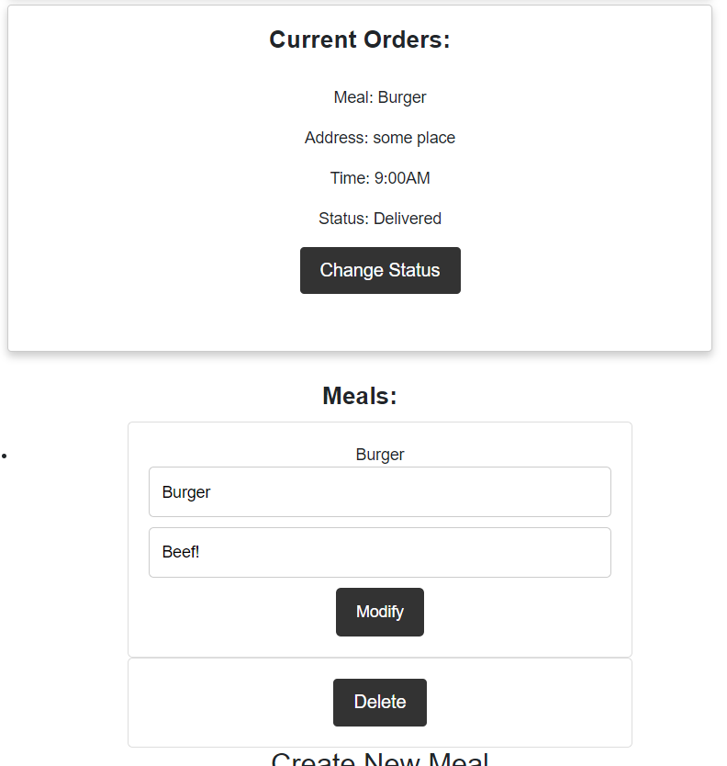
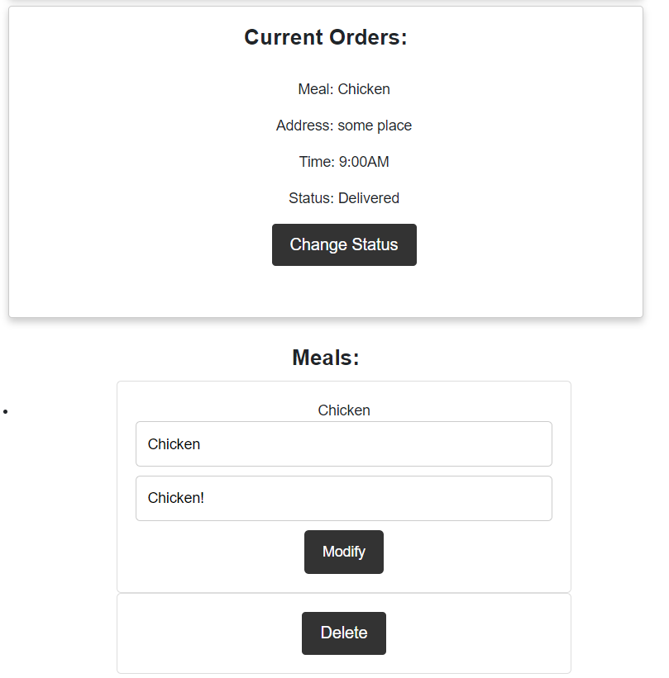
Modify Meals
Meals are displayed below the “Current Orders” section within cards containing input text boxes that makes it easy for admins to modify the information for meals by changing the text inside and clicking “Modify”. Content will be reloaded and the updated meal information is displayed.

Slide 10
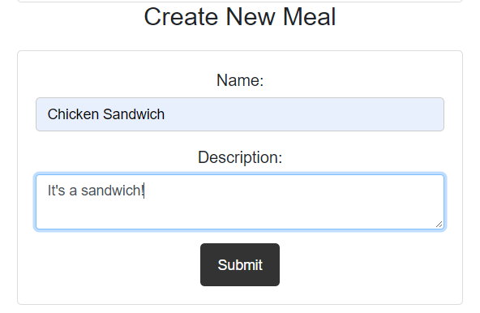
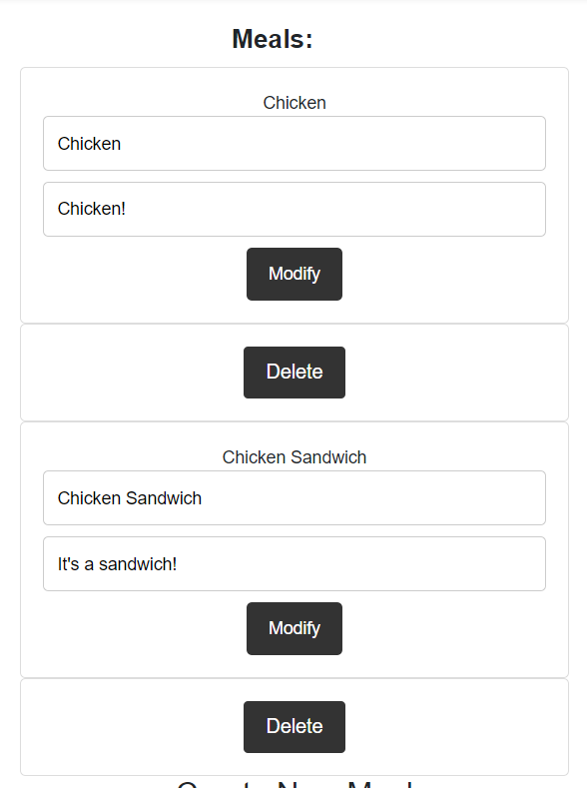
Create New Meal
Below the information for current meals of a restaurant, admins can create new meals with a name and description. Clicking “Submit” reloads the content and displays the new meal at the bottom of the list of current meals.

Slide 11
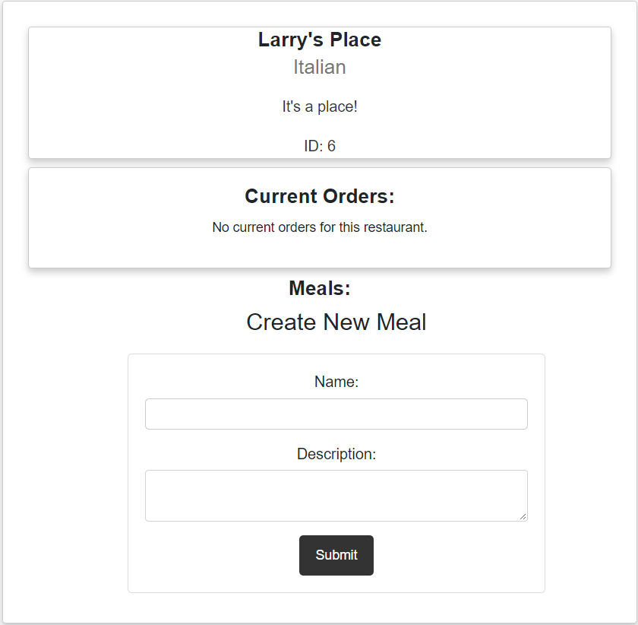
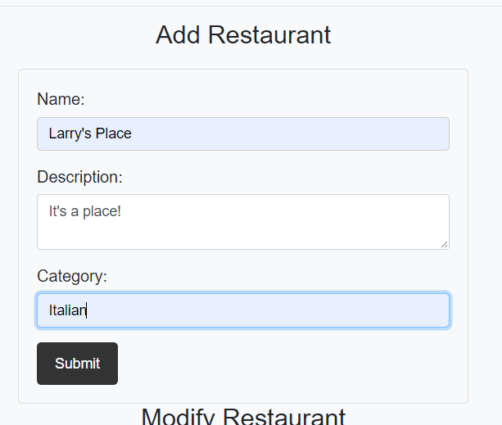
Add Restaurant
Below all the information for current restaurants and their meals, admins may add, modify and delete restaurants. This display shows the adding of a restaurant that will be displayed at the end of the list of current restaurants when the “Submit” button is clicked.

Slide 12
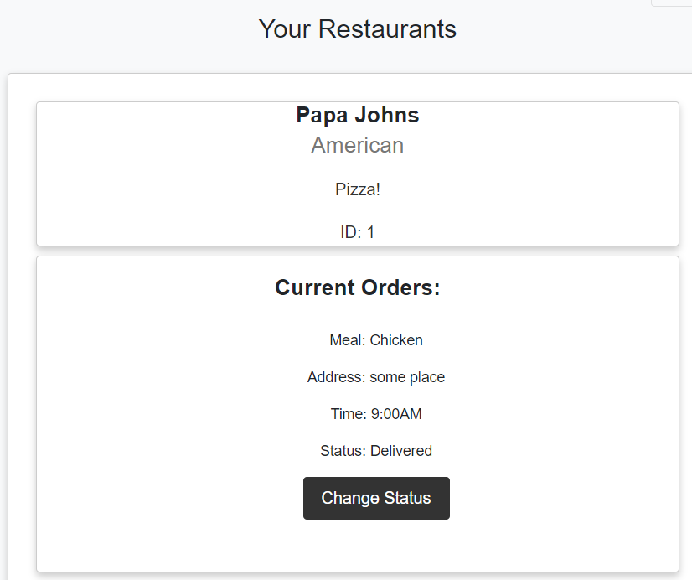
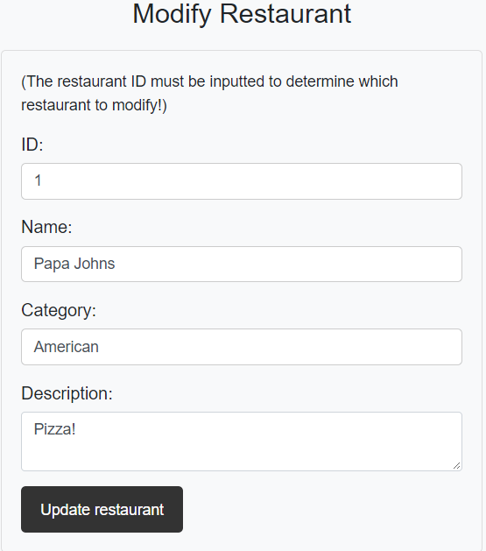
Modify Restaurant
In the next section, admins are able to input the “ID” of the restaurant they’d like to modify. Upon clicking “Update restaurant” admins will see the information of the selected restaurant updated to what they have specified.

Slide 13
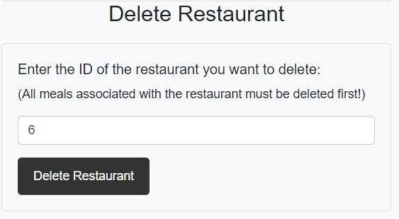
Delete Restaurant
At the bottom of the “Admin Page”, admins have the ability to select the restaurant they’d like to delete, determined by the inputted value for “ID”. Clicking the “Delete Restaurant” button results in the content being reloaded and the selected restaurant being removed.

